Slide 1
4 The Relational Data Model and Relational Database Constraints (3 LHR)
Relational Model Concepts; Relational Model Constraints and Relational Database Schemas;
Update Operations, Transactions and Dealing with Constraint Violations

Slide 2
Relational Model
A database is a collection of interrelated data and the way data is related to each other depends upon the model being used.
Three types of model are in use: Hierarchical Model, Network Model and Relational Model
A relational database is a collection of relations or tables having distinct names.

Slide 3
Relational Model Concepts
The relational model is today the primary model for commercial data processing applications.
It has attained its primary position because of its simplicity as compared to earlier data models such as the network model or the hierarchical model.
It is a lower level model that uses a collection of tables (also called relations) to represent both data and the relationship among those data.
Each table has multiple columns and each column has a unique name.

Slide 4
Relational Data Model Concepts
In relational model, the data and relationships are represented by collection of interrelated tables.
Each table is a group of columns and rows, where column represents attributes and rows represents the records.
Relational data model represents the logical view of how data is stored in the relational databases.

Slide 5
Structure of Relational Database
The relational model represents both data and the relationships among those data using relation.
A relation is used to represent information about any entity (such as book, author etc) and its relationship with other entities in the form of attributes (columns) and tuples (rows).
A relation comprises of a relation schema and a relation instance.
A relation schema consists of a relation name R and its set of attributes or fields A₁, A₂…..A_{n}.
It is represented by R(A₁,A₂,A₃….A_{n}) and is used to describe a relation R.
A set of relation schemas {R₁,R₂,R₃,….R_{n}} together with a set of integrity constraints in the database makes relational database schema

Slide 6
Relational Database Schemas
A schema is the structure behind data organization.
In a schema diagram, all database tables are designed with unique columns and special features for example primary keys, foreign keys or not null etc.
Schema diagrams have an important functions because they force database developers to transpose ideas into paper.
Schema provides the an overview of entire database.

Slide 7
Relational Database Schema
Example: College Management System (CMS)
Department(dept_id, dept_name,dept_block_no)
Student(stu_id, stu_name, stu_address, dept_id)
Staff(staff_id, staff_name, dept_id)
Subject(sub_id, sub_name, sub_code, staff_id)
Marks(marks_obtain, sub_id, stu_id)

Slide 8
CMS
Department
Staff
Dept_id | Dept_name | Dept_block_no
1 | Computer | 100
2 | Mathematics | 200
3 | Economics | 300
4 | Account | 400
5 | Physics | 500
Staff_id | Staff_name | Dept_id
11 | Mohan | 1
22 | Pratima | 2
33 | Madan | 1
44 | Kamala | 3
55 | Sandhya | 4
66 | Umesh | 3
77 | Ramesh | 1

Slide 9
CMS
Marks
Student
Marks_obtain | Sub_id | Stu_id
60 | 20 | 10
55 | 21 | 12
58 | 22 | 10
49 | 20 | 13
61 | 23 | 14
67 | 22 | 13
60 | 24 | 16
55 | 26 | 15
33 | 25 | 11
Stu_id | Stu_name | Stu_address | Dept_id
10 | Maya | Palpa | 1
11 | Abin | Ktm | 2
12 | Aarav | Ktm | 1
13 | Ashna | Palpa | 3
14 | Anuj | Pokhara | 4
15 | Manish | Banepa | 2
16 | Pinky | Ktm | 1

Slide 10
CMS
Subject
Sub_id | Sub_name | Sub_code | Staff_id
20 | DBMS | D-20 | 11
21 | C++ | C-21 | 22
22 | NM | N-22 | 11
23 | TOC | T-23 | 77
24 | PHP | P-24 | 44
25 | AI | A-25 | 33
26 | ASP | A-26 | 55
27 | CG | C-27 | 66
28 | C-Programing | C-28 | 44

Slide 11
Relational Model Constraints
Relational Integrity constraints are referred to conditions which must be present for a valid relation.
These integrity constraints are derived from the rules in the mini world that the database represents.
It assures that the data adhere to the set of rules defined by the database administrator and hence, prevents the entry of the invalid information into database.

Slide 12
Data Integrity
There are mainly four types of Data integrity
Domain Integrity
Entity Integrity
Referential Integrity
User Defined or Semantic Integrity (Triggers, Checks , Assertions)

Slide 13
Domain Integrity
A domain represents a set of accepted values that can be assigned to an attribute.
Domain integrity constraint is specified on the column of a relation, so that correct values can be entered in the column for each record.
The domain integrity states that every element from a relation should respect the type and restrictions of its corresponding attribute.
Any entry which we make for a column should be available in the domain of the data type. For example, in Date column, correct dates are entered not any invalid values.

Slide 14
Domain Integrity
For example, we can specify the value of ‘Marks’ attribute of ‘Student’ table which must be greater than 0 and less than or equal to 100.
Eid | EName | Salary | Age
101 | Anup Baral | 40000 | 25
102 | Bhumi Acharya | 50000 | 35
103 | Basanta Joshi | 30000 | 56
104 | Biru Amatya | 35000as | 22
Here, the salary of Biru is not in domain
,so it is not accepted.

Slide 15
Entity Integrity
The entity integrity ensures that no primary key value be null. This is because the primary key is used to identify individual tuples in a relation.
Having null value for the primary key implies that we cannot identify some tuples.
This also specifies that there may not be any duplicate entries in primary key column.

Slide 16
Entity Integrity
In the following table Eid is a key attribute of Employee.
Eid | EName | Salary | Age
101 | Anup Baral | 40000 | 25
102 | Bhumi Acharya | 50000 | 35
103 | Basanta Joshi | 30000 | 56
101 | Biru Amatya | 35000as | 22
Key constraint violets

Slide 17
Referential Integrity
The referential integrity constraint is specified between two relations and is used to maintain the consistency among tuples in the two relations.
The referential integrity states that if a foreign key in the first table refers to the primary key of the second table then every value of foreign key in the first table should either be null or present in the second table.
It is a rule that maintains consistency among the rows of the two relations

Slide 18
Referential Integrity
Referential integrity constraint ensures that changes, insertion, deletion in the database maintains data integrity.
Examples:
Let us consider following two tables:
Rol_no | SName | Age | Course_id
1 | Kamal | 21 | 22
2 | Bimal | 22 | 11
3 | Suman | 20 | 22
4 | Himal | 19 | 11
Course_id | Course_Name | Duration
11 | Java | 4
12 | DBMS | 3

Slide 19
User Defined or Semantic Integrity
Domain integrity, referential integrity, key integrity are not enough to maintain data integrity.
To represent real world accurately and consistently, business rules and logical rules must be enforced in database.
Such rules are derived from our knowledge of the application semantics and are called semantic integrity constraints.
Such integrity is typically implemented through triggers and stored procedures.

Slide 20
User Defined or Semantic Integrity
Triggers are block of statements which executes automatically if any predefined events occur.
Semantic integrity ensures that data in the database is logically consistent and complete with respect to the real world.
This type of integrity cannot be represented by the model and contains integrity constraints like:
Number of pages of book cannot be zero
A author cannot review his own book
Salary of manager is greater than salary of all other employee

Slide 21
Trigger
A trigger is a procedure stored in the database that is executed automatically by the database engine whenever a particular action occurs such as a row being updated.
Triggers are used to enforce complex forms of referential integrity or to log activity on the database;
The SQL Standard defined two types of triggers: row-level triggers and statement level triggers.

Slide 22
Triggers
Row Level Triggers: It is activated for each row that is inserted, updated or deleted.
For example, if a table has 100 rows inserted or deleted, the trigger is automatically invoked 100 times for the 100 rows affected.

Slide 23
ROW Level Trigger
The trigger to compute age difference is as follows:
CREATE OR REPLACE TRIGGER Age_Change
BEFORE DELETE OR INSERT OR UPDATE ON Student
FOR EACH ROW
when (:NEW.age>0)
DECLARE
age_diff number;
BEGIN
age_diff:=:NEW.age-:OLD.age;
dbms_output.put_line(‘Previous Age’||:OLD.age);

Slide 24
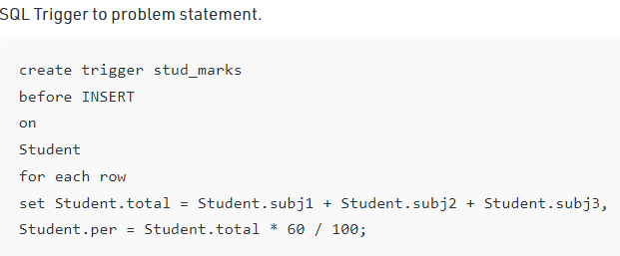
Triggers
1-<number>

Slide 25
Triggers
Statement Level Trigger: It is executed once for each transaction regardless of how many rows are inserted, updated or deleted.

Slide 26
Statement Level Trigger
A statement level trigger is fired only once on behalf of the triggering statement, regardless of the number of rows in the table that triggering statement affects, even if no rows are affected. For example, if a DELETE statement deletes several rows from a table, a statement-level DELETE trigger is fired only once.
Statement triggers are useful if the code in the trigger action does not depend on the data provided by the triggering statement or the rows affected. For example, use a statement trigger to:
Make a complex security check on the current time or user
Generate a single audit record

Slide 27
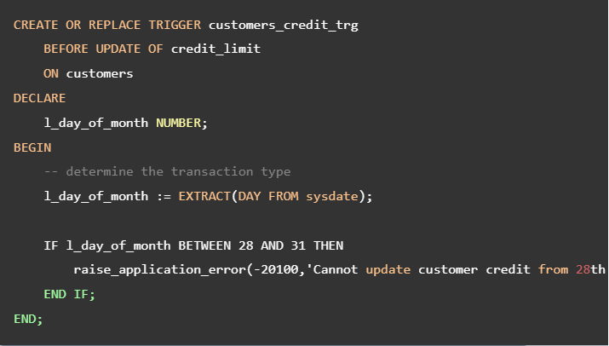


Slide 28
CHECK Constraint
This constraint is used for specifying range of values for particular column of a table.
When this constraint is being on a column, it ensures that the specified column must have the value falling in the specified range.
The CHECK constraint may use the name of the attribute in a relation.
The attribute value is checked only when the value of the attribute is inserted or updated. It is a local constraint

Slide 29
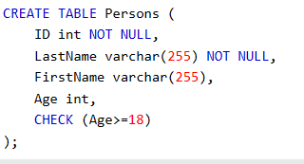
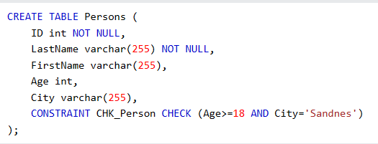
CHECK Constraint

Slide 30
Assertions
Assertions are general purpose checks that allow the enforcement of any condition over the entire database.
Similar to CHECK but they are global constraints.
Assertions are not defined on table or column level but are defined on schema level.
When assertion is made, the system tests it for validity and any tests it again on every update that may violate the assertion.
This testing may introduce a significant amount of overhead; hence assertions should be used with great care.

Slide 31
Assertions
An assertion in SQL takes the form
Create assertion <assertion-name> check<predicate>

Slide 32
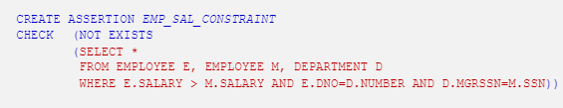
Assertions
Salary of employee is always less than salary
manager
1-<number>

Slide 33
Update Operations, Transactions and Dealing with Constraint Violations
There are three basic operations that can change the states of relations in the database. Insert, delete and update.
Whenever these operations are applied, the integrity constraints specified on the relational database schema should not be violated.

Slide 34
Insert Operations
The insert operation provides a list of attribute values for a new tuple that is to be inserted into relation R.
Insert operation can violates
Domain Constraints
Key Constraints
Referential Constraints
Domain constraint can be violated if an attribute value is given that does not appear in the corresponding domain. Key constraint can be violated if key value in the new tuple t already exists in another tuple in the relation R.

Slide 35
Insert Operation
Referential integrity can be violated if the value of any foreign key in t refers to a tuple that does not exist in the referenced relation. Example:
Staff_Id | Staff_Name | Dept_Id
11 | Mohan | 1
22 | Pratima | 1
33 | Madan | 3
44 | Kamala | 4
55 | Sandhya | 3
66 | Umesh | 1
77 | Ramesh | 3
Dept_id | Dept_Name | Dept_Block_No
1 | Computer | 100
2 | Mathematics | 200
3 | Economics | 300
4 | Account | 400
5 | Physics | 500

Slide 36
Insert Operation
In the department table we can not insert new record (6,’English’,454.78) because value of attribute dept_bloc_no is in floating point which violates the domain constraint.
We can not insert a new record (4, ‘English’, 700) into department table because the key value 4 is already exist in the department table.
We can not insert the new record (12,”lalit’, 6) to staff table because their reference was not present at department table

Slide 37
The Delete Operation
The delete operation can violate only referential integrity.
This occurs if the tuple being deleted is referenced by foreign keys from other tuples in the database.
From the above tables, we can not delete the record {1,’Computer’, 100} from department table because their reference is saved to their child table Staff, so deleting this it violates the foreign key constraint.

Slide 38
Update Operation
The update operation is used to change the values of one or more attributes in a tuple of some relation R.
It is necessary to specify a condition on the attributes of the relation to select the tuple to be modified.
Example: we can not change the record {1,’computer’, 100} to {9, “computer”,100} because their reference is saved to their child table “staff”

Slide 39
The Transaction Concept
A database application program running against a relational database typically executes one or more transactions.
A transaction is an executing program that includes some database operations such as reading from the database, or deletions or updates to the database.
At the end of transaction, it must leave the database in a valid or consistent state that satisfies all the constraints specified on the database schema.

Slide 40
The Transaction Concept
A single transaction may involve any number of retrieval operations or any number of update operations.
These set of operations will together form an atomic unit of work against the database.
A large number of commercial applications running against relational database is online transaction processing (OLTP) systems are executing transactions at rates that reach several hundred per second

Slide 41
Advantages of using Relational Model
Simplicity: The relational data model is simpler than hierarchical and network data model
Easy to Use: The relational model is easy as tables consisting of rows and columns is quite natural and simple to understand.
Structural Independence: The relational database is only concerned with data not with a structure. This can improve the performance of the model.

Slide 42
Advantages of using Relational Model
Data Independence: The structure of a database can be changed without having to change any application.
Scalable: Regarding a number of records, or rows, and the number of fields, a database should be enlarged to enhance its usability

Slide 43
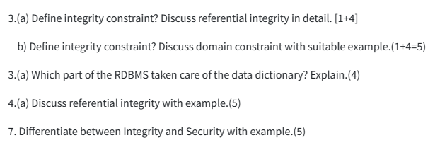
TU Questions

